Slide 1
Introduction to Programming and IDEs!
CYBR 493A

Slide 2
This is your guide to prepare your computer to code for CYBR493

Slide 3
Table of contents
What is programming?
Introduction to IDEs
Eclipse IDE for Java Development
Compilers Vs. Interpreters
Benefits of using Eclipse
Version Control (GitHub)
Prepare your computer for coding in MIST352
Cloning repo using Eclipse

Slide 4
What is Programming?
Programming is the art of instructing computers to perform tasks.
It involves providing clear and structured commands that a computer can understand and execute.
In today's technology-driven world, programming is a fundamental skill with diverse applications.
We write “source code” of programs, the computer translates those into something “cool”.

Slide 5
Source Code Files: Fancy Text with Extensions
At its core, source code is composed of plain text files.
These files contain human-readable instructions written in programming languages.
The choice of extension, such as .java for Java or .py for Python, indicates the language used.

Slide 6
Introduction to IDEs
An Integrated Development Environment (IDE) is a software suite that combines various tools to aid developers in creating and managing code.
IDEs offer features like code editing, debugging, version control, and more, all within a unified interface.

Slide 7
The Need for IDEs
While basic text editors can be used for programming, IDEs offer a more efficient workflow.
They provide tools that enhance productivity, such as code completion, error checking, and integrated debugging, making development smoother and faster.

Slide 8
Compilers vs. Interpreters
Compilers and interpreters are tools for translating code into machine-readable instructions.
Compilers, like the one in Eclipse, convert code to bytecode before execution.
Interpreters, on the other hand, execute code line by line, as seen in languages like Python.

Slide 9
Introduction to Version Control
Version control are computer systems that track changes to code over time, enabling collaboration and safeguarding against mistakes.
They ensure that developers can work on projects simultaneously without overwriting each other's work.

Slide 10
Git and GitHub
Git is a distributed version control system that tracks changes locally.
GitHub, a platform built around Git, offers remote repositories for collaborative development, code review, and issue tracking.

Slide 11
GitHub Integration with Eclipse
PyCharm seamlessly integrates with GitHub, simplifying version control within the IDE.
This integration streamlines tasks like committing changes, branching, and merging.
Using this feature is OPTIONAL in our class. Instead, we will use the command line to link your projects to your GitHub account.

Slide 12
Collaborative Development with PyCharm
PyCharm’s GitHub integration enhances collaborative development.
Developers can work on the same project, manage changes, and resolve conflicts efficiently, promoting teamwork and code stability.

Slide 13
PyCharm User Interface
Eclipse's user interface is divided into perspectives, views, and editors.
Perspectives customize the workspace for specific tasks, while views and editors provide tools for code editing, project management, and more.

Slide 14
IDEs in Professional Software Development
In professional software development, IDEs play a pivotal role.
They streamline coding, debugging, and testing, leading to faster development cycles, fewer errors, and improved software quality.

Slide 15
Future Trends in IDEs
IDEs are evolving with emerging technologies.
AI-powered code suggestions, automated refactoring, and enhanced collaboration tools are shaping the future of IDE development.

Slide 16
Conclusion
In this presentation, we explored the world of programming, IDEs, and the PyCharm IDE.
IDEs like PyCharm are essential tools for modern developers, providing an integrated environment for efficient and collaborative software development.

Slide 17
What is GitHub?
So, we write code locally using Eclipse, how can we allow others to see this code?
How can we allow others to even contribute to this code?
The answer is the cloud.
GitHub is a “cloud” service that allows you to save code and maintain different “version” of the code
GitHub is a cloud based version control system.

Slide 18
How does GitHub work?
Simple, it allows you to have an online repository to save –and share- any data you want
Mostly used for coding projects
In our class, you will be submitting all of your homeworks, in-class tasks, and other coding assessment to GitHub.
You need to create an account using your mix account
Then you can create a repository, see next slides.

Slide 19
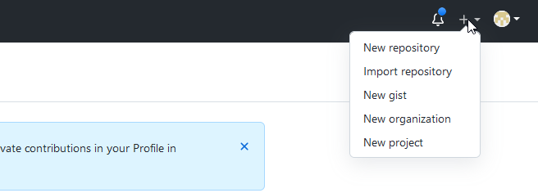
Create GitHub repository for CYBR493A
Go to GitHub.com and create an account using your mix account.
Click on the (+) sign on the right top corner of your repository and click New Repository as shown below.

Slide 20
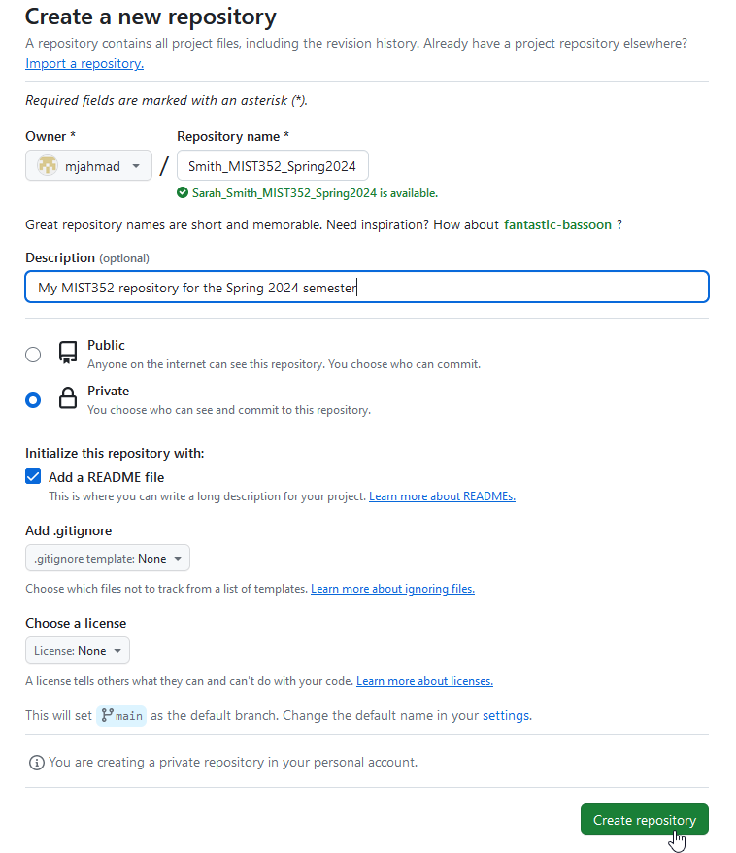
Create GitHub repository for CYBR493A
Mohamamd_Ahmad_CYBR493A_Fall24
My CYBR493 Repo for Fall 2024
3.Name your repository EXCATLY like this:
[First Name]_[Last Name]_MIST352_Spring2024
So if your name is Sarah J. Smith, then your repository should be named
Sarah_Smith_CYBR493A_Fall24
4. Make your repository private
5. add a README file. And then create repository.

Slide 21
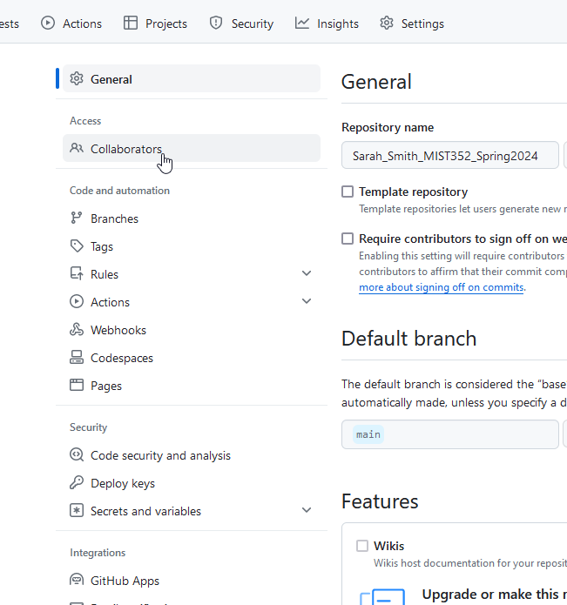
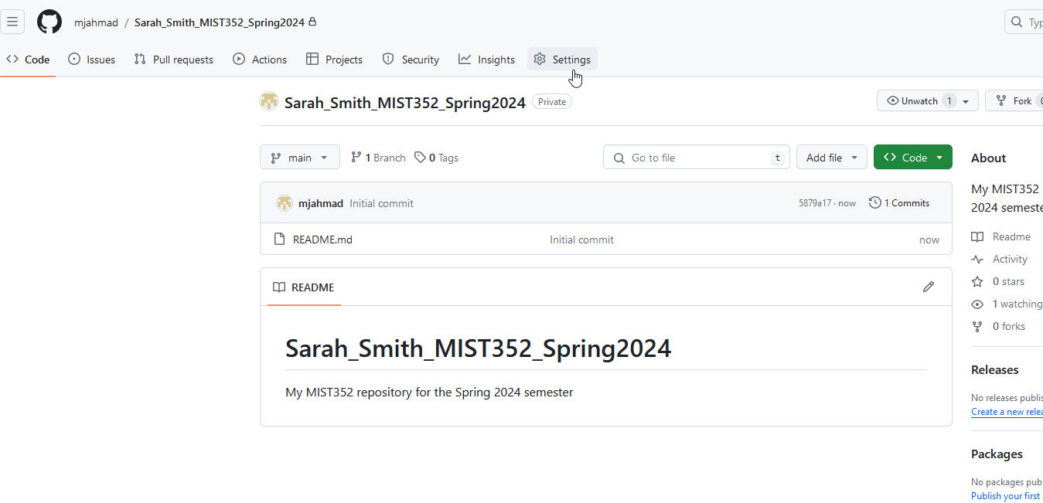
Add collaborators to your GitHub
Next, You need to add Dr. Ahmad as a collaborator.
This is the only way Dr. Ahmad can se you and grade your code.
Go to settings and add (mahmad2@mix.wvu.edu) as a collaborator

Slide 22
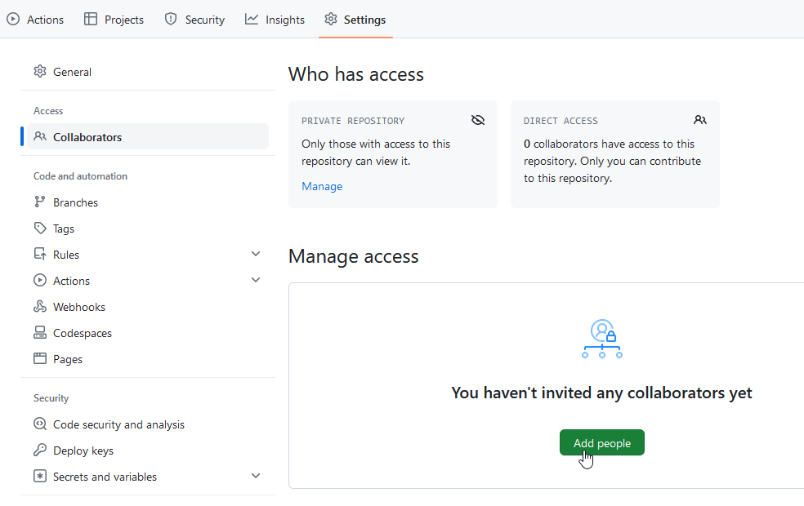
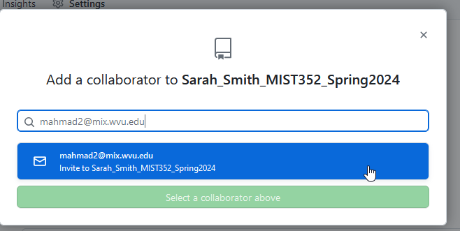
Adding collaborators

Slide 23
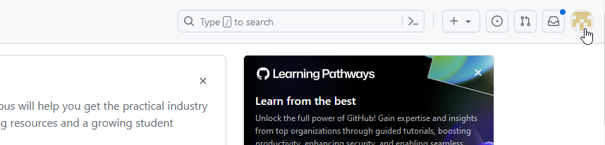
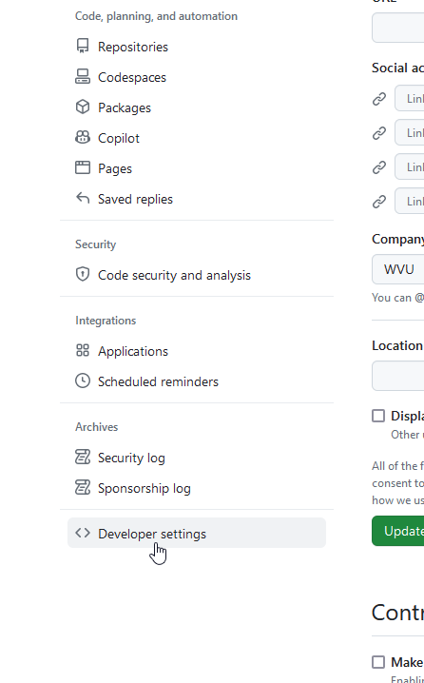
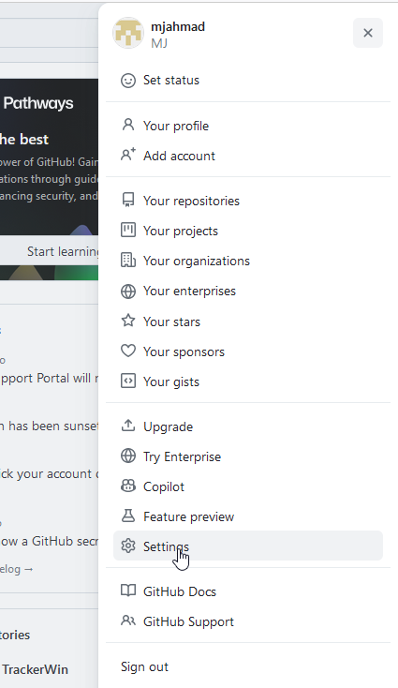
Obtain GitHub personal token code
Next, we need to obtain a token from GitHub to allows us to interact with the online repository.
On GitHub, go to your account setting
Scroll down and go to Developer settings
Go to Personal access tokens
Go to Tokens (classic) -> Generate new token
Go to Generate new token (classic)
Set date to 5/30/2024
Check all boxes -> Generate Token
SAVE your personal token in a secured file
You will never see this token again. If you lose, then you will need to create a new token.
See next slides for screenshots

Slide 24
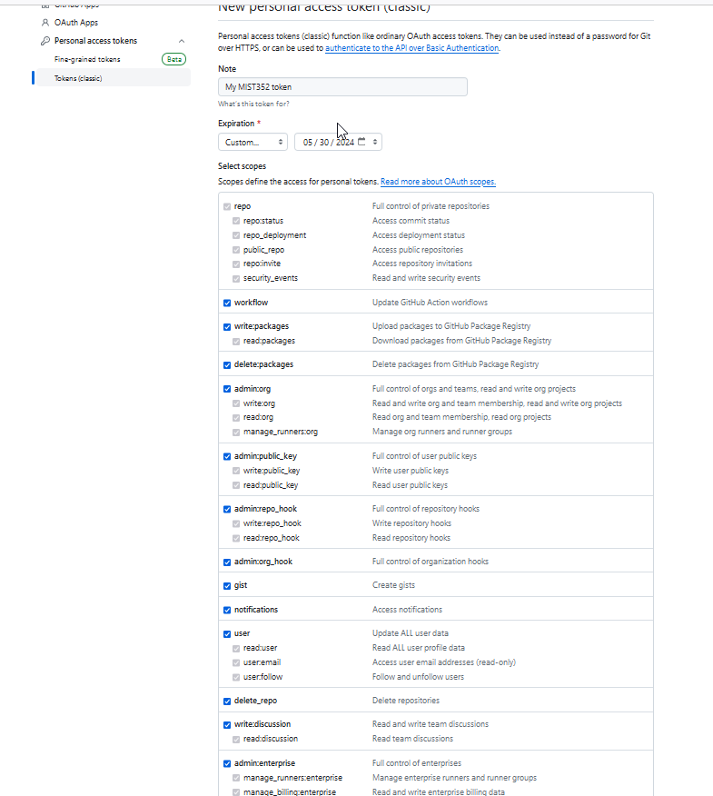
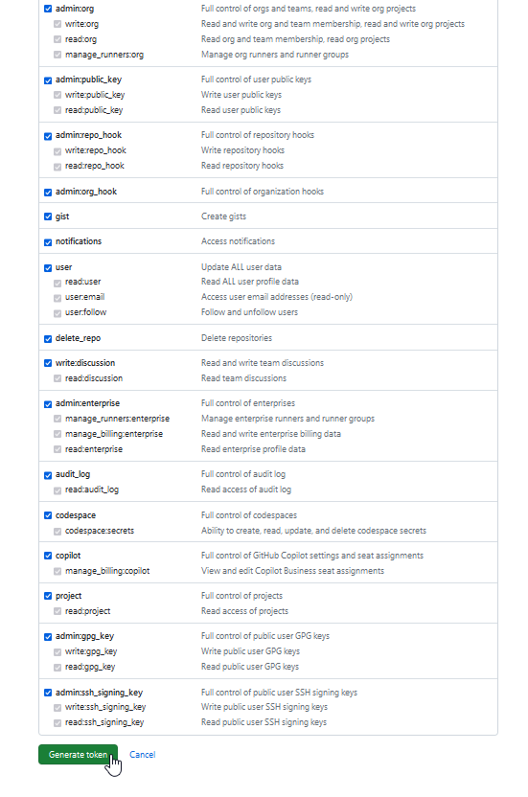

Slide 25
Git, one last thing
Now we need an application to allow us to synch data and code from the online repository (GitHub) to our local computers.
Git does that.
Before you download Git, check whether you have it or not. See next slide
Download and install Git.

Slide 26
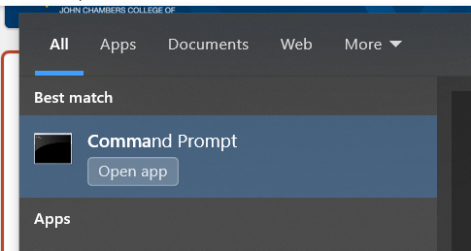
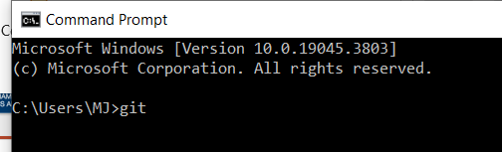
Check whether you have Git or not
Go to the command line (on windows) or the terminal (on mac).
Go to menu and type command line
In the command line, type git and hit enter

Slide 27
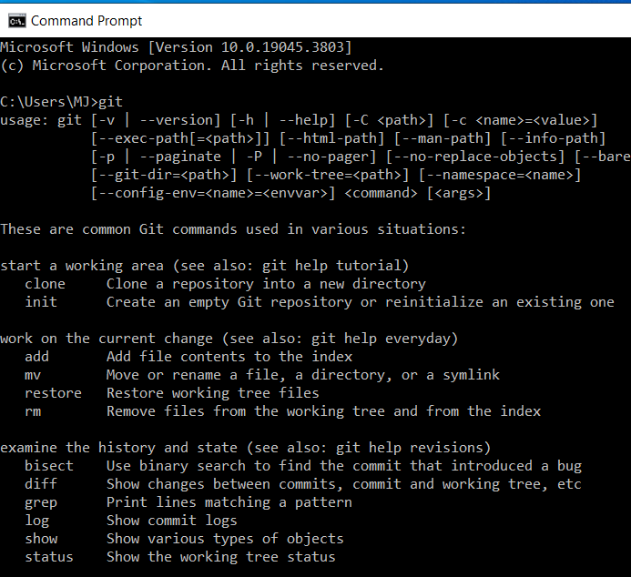
If you have git, you should see the screen below, otherwise you will see “not found” or “not recognized”:

Slide 28
If Git is not installed
Download Git and install
If asked for credentials, provide your GitHub user name and the token you obtained.
Once installed, check from the command line/ terminal again using the command in the previous slide.

Slide 29
Putting the whole thing together prepare your computer for Cybr493A coding

Slide 30
Create folder for CYBR493A
Now you should have PyCharm and Git installed, and GitHub configured, we need to create the proper folders on your computer.
Although you may skip these steps, you are highly encouraged to flow this structure.
On your computer, navigate to the desktop or any other location and create a folder named CYBR493A _Fall2024

Slide 31
The CYBR493A_Fall2024 folder
Inside this folder, you will eventually add two repositories:
The CYBR493A class’s repository: This is where Dr. Ahmad upload all source codes related to this class (Link is on eCmapus)
Your own repository: This is where you should keep all of your codes, submit assessments, etc..
Next slides will show you how to clone each.

Slide 32
Clone the MIST352 repository
As stated earlier, this is the class’s GitHub repository.
We will use git commands in the command line/ terminal to clone each of these two repositors into our local MIST352_Spring2024 folder.
Each repository will be in a separate folder
Go to your command line/ terminal and navigate to the location of the MIST352_Spring2024 folder
To navigate, see the next slide

Slide 33
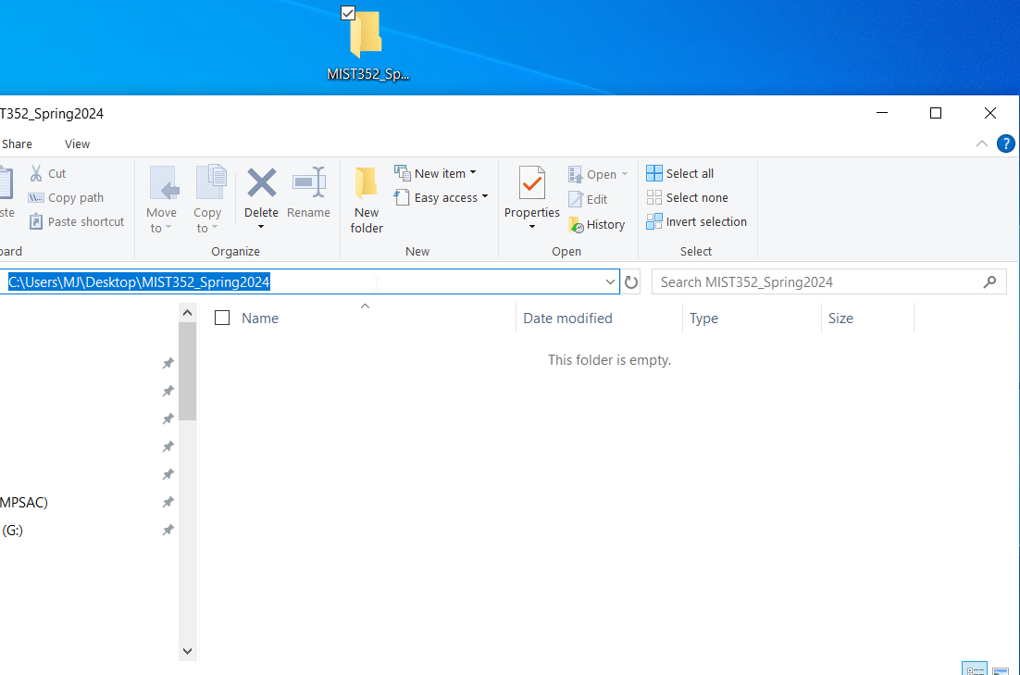
Navigate to local folder from the command line/ terminal
First, we need to know where the folder is, to do that, open that folder and click on the address bar
Now you can see that the folder is on my (C:\Users\MJ\Desktop\MIST352_Spring2024) directory.
Yours will be different of course.
Copy this link and go to command line/ terminal

Slide 34


Navigate to local folder from the command line/ terminal
Once in the command line/ terminal type: cd [location you copied in previous slide]
cd stands for “change directory”
The command line/ terminal should now be inside the MIST352_Spring2024 folder as shown in the second screenshot.

Slide 35
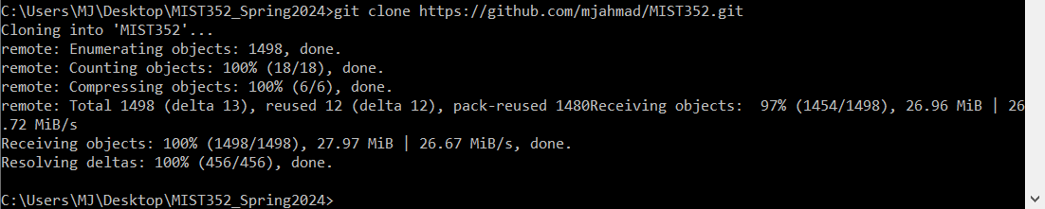
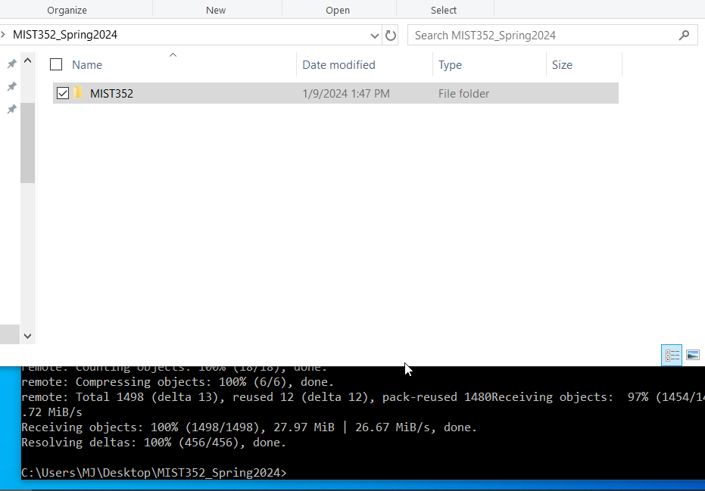
Clone repositories
Once your command line/ terminal is inside the correct directory, type:
git clone https://github.com/mjahmad/MIST352.git
Now, open the MIST352_Spring2024 folder, you should see the MIST352 folder there

Slide 36
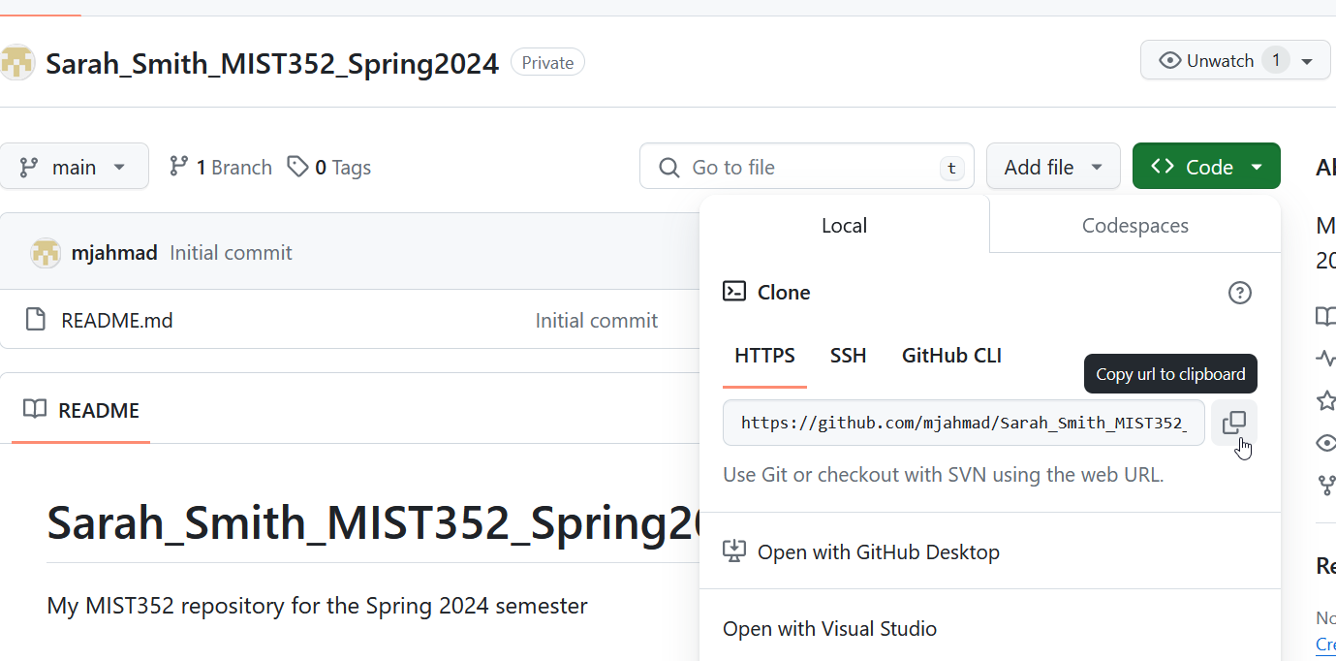
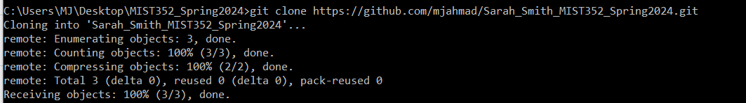
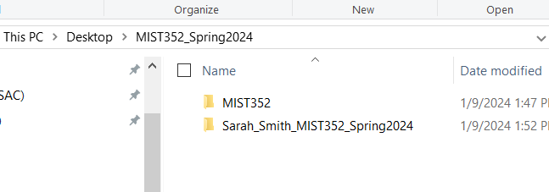
Clone your own repository
Go to your GitHub’s account online and obtain the clone link.
Copy the code and go back to the command line/ terminal
Make sure –again- that the command line / terminal is setting inside the MIST352_Spring2024 folder
Type git clone [link you copied for your repo]
Now, you should see two folders inside the MIST352_Spring2024 folder
MIST352
Your own

Slide 37
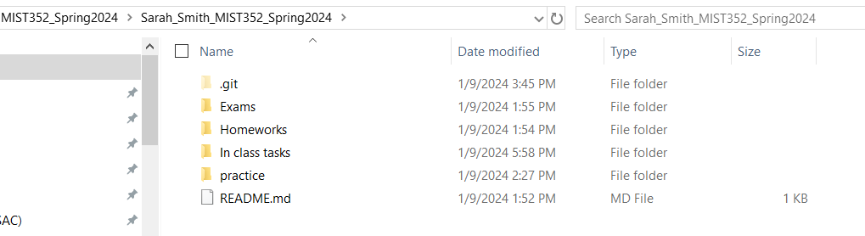
Prepare your local folder
Go to your local repository folder and create the following folders (exactly as they are named)
Exams
Homeworks
In class tasks
practice
(you will other things in this folder, just ignore them).

Slide 38
Create your first java project
Now you have your computer ready to starting coding and pushing code to GitHub.
The git command/ operation “push” means: take the changes I made to my local repository, and push it to the cloud (synch it).
We will be using a set of git commands to do that.
First, lets create a java project

Slide 39
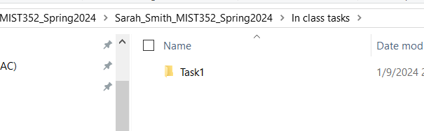
Create your first java project
The easiest way is to first create a folder for the project you want to create, then launch eclipse to start coding.
Go to the In class tasks folder and create a folder named Task1
From now on, when being asked to create a new java project, create a folder for that project first, before coding with eclipse.

Slide 40
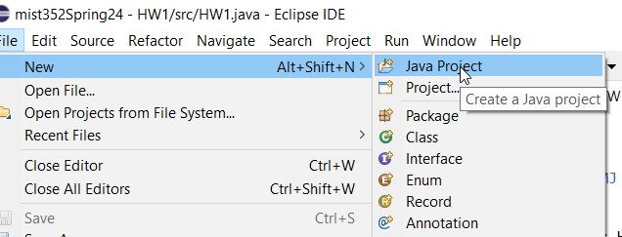
Create your first java project
Start Eclipse -> leave default options
Go to File -> New ->Java Project
Uncheck (Use default location) and brows to the folder you created for this project.
In this case browse to Task1 folder

Slide 41
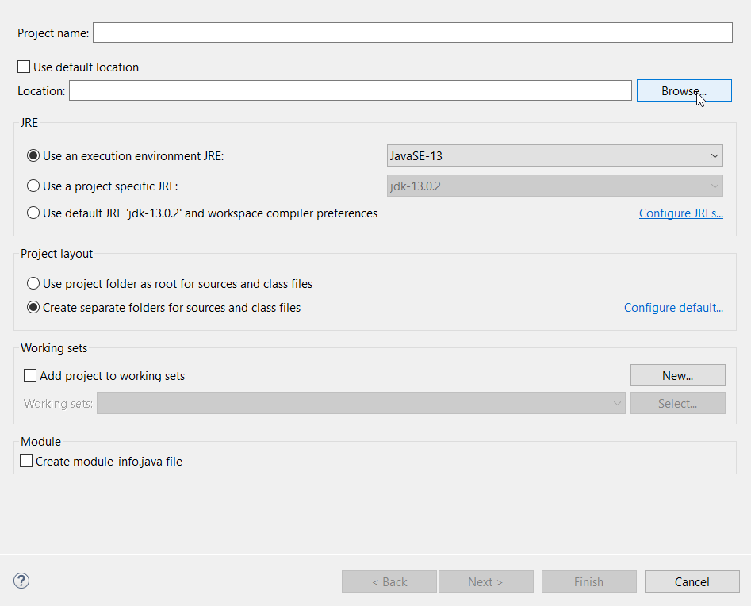
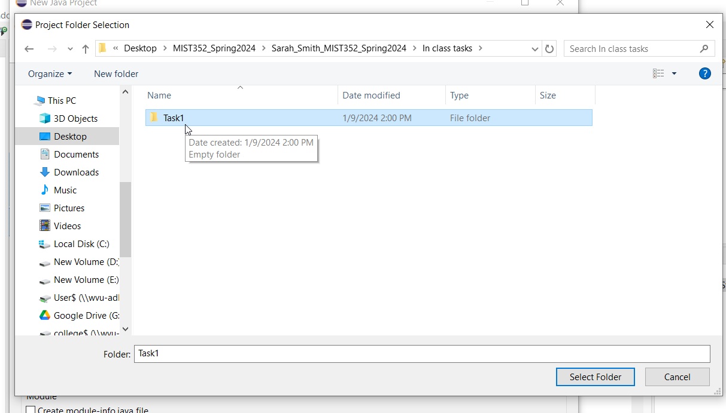
Create your first java project
Select the foder
-Uncheck [Check module-info.java file”

Slide 42
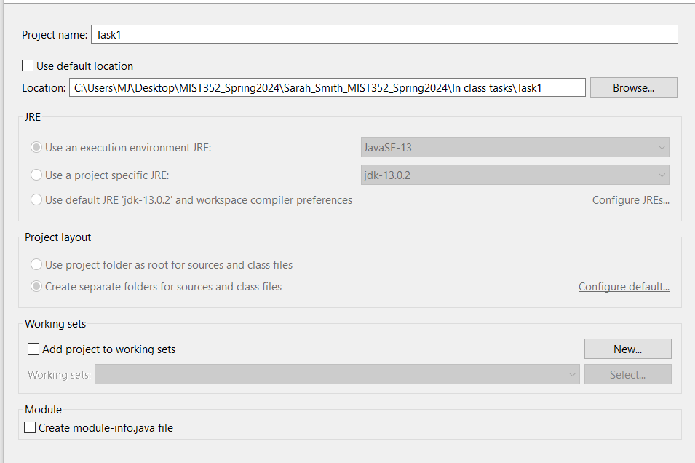
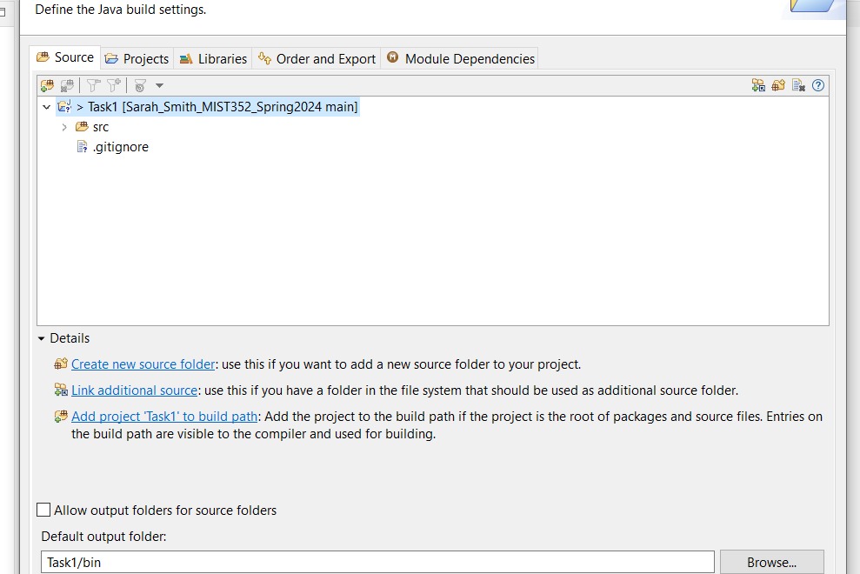
Hit Next, then Finish

Slide 43
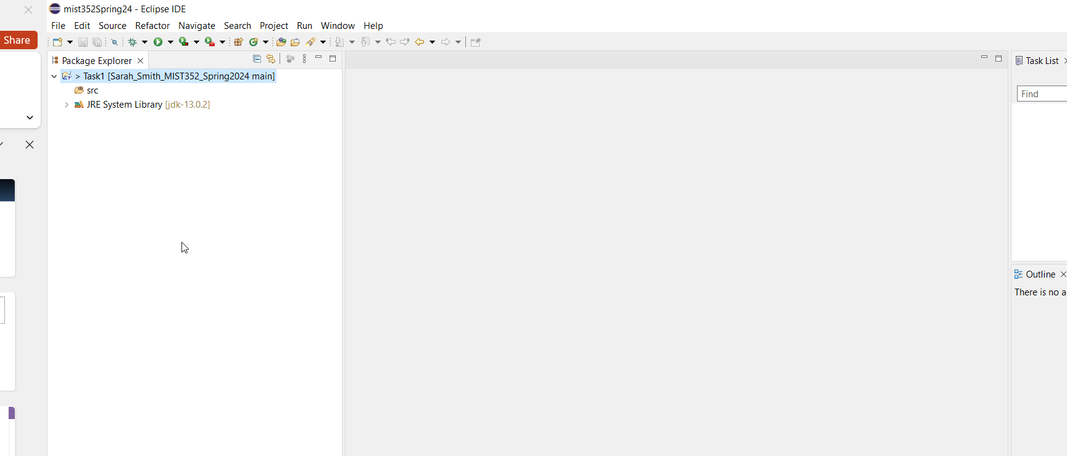
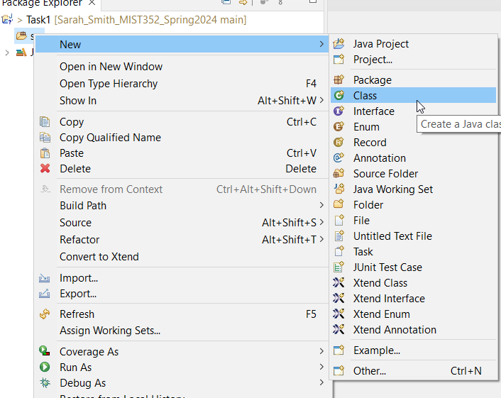
Adding java class to project
Once the project is created, we need to start adding java files.
Java files are where we actually write the code
On Eclipse’ package explorer, expand the Task1 folder -> right click on the src folder -> New -> Class

Slide 44
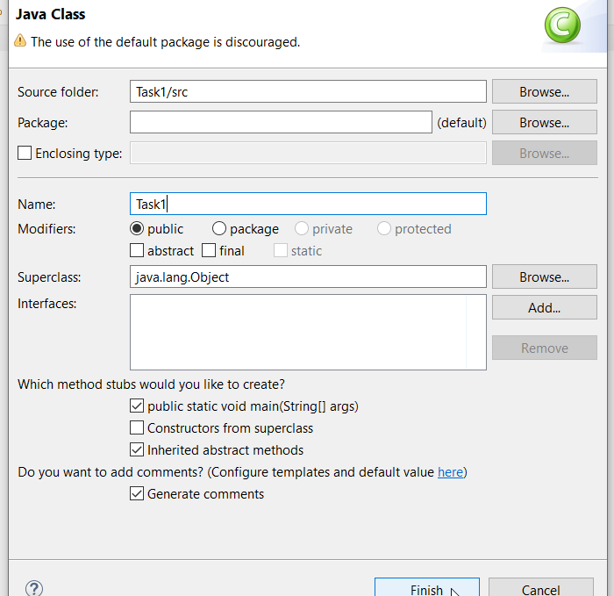
Adding java class to project
Nam the files similarly to the project name (this might change in the future)
Check the options as given in the screenshot
Hit Finish

Slide 45
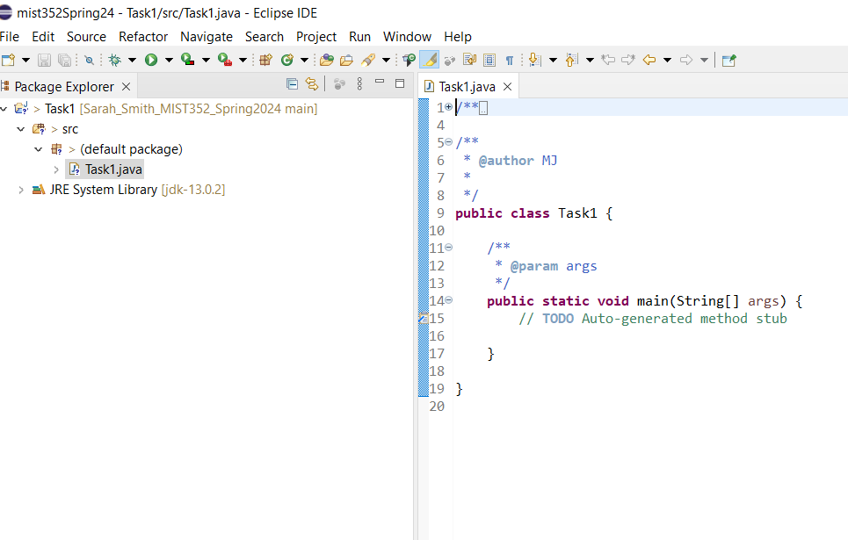
Welcome to Eclipse
Now, we start coding

Slide 46
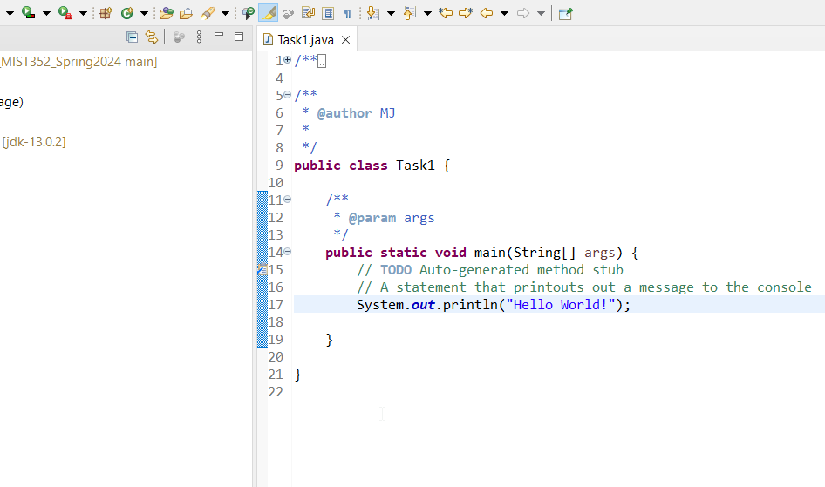
Write your first program
For now, your code should go inside the two {} that belong to “public static void….” sentence
Write the command in line 17 in the screenshot
This is case sensitive
No place for any mistakes

Slide 47
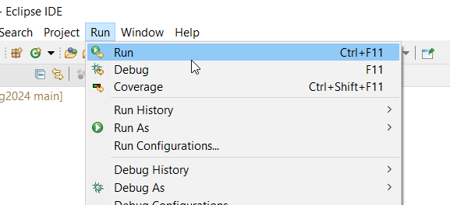

Run you first program
Run your program
You should see an output on your console

Slide 48
Sync “push” project to GitHub
There are multiple ways to push yoiur projects/ changes to GitHub
The easiest is to use Git commands from the command line/ terminal
Open command line/ terminal and navigate to the repository you want to sync.
See next slide

Slide 49
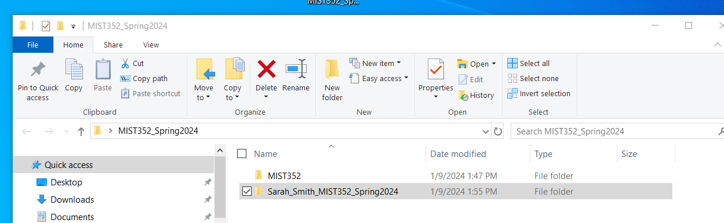
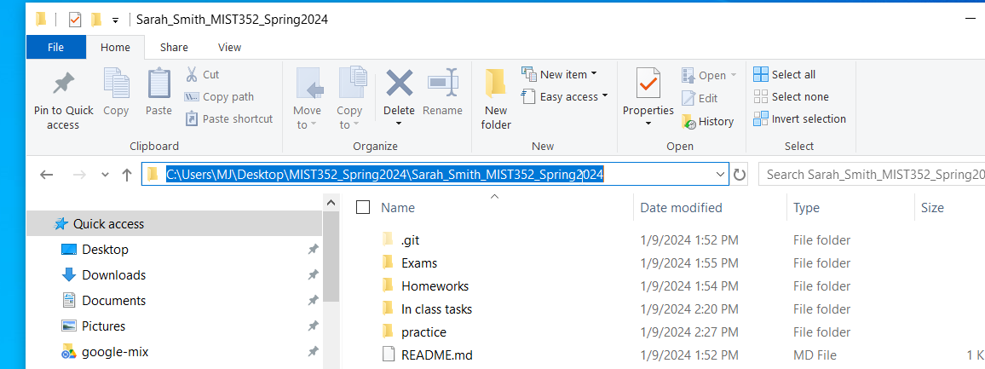
Navigate to your local repo
Go to your local repository
Copy its location as shown below

Slide 50
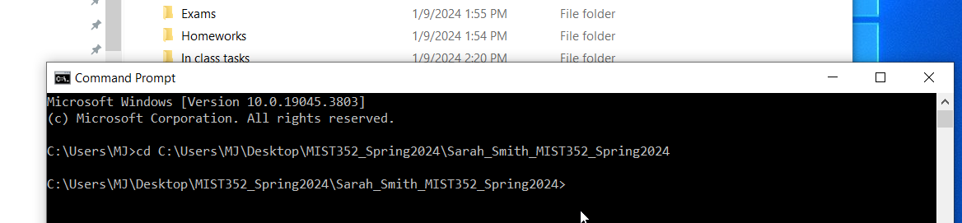
Navigate to your repo from command line/ terminal
Now type cd [location you copied in the previous slide]

Slide 51
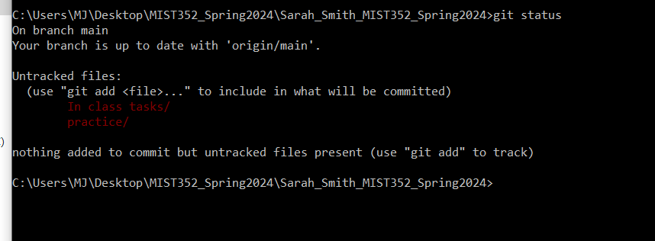
Push changes to GihHub using git
Now run the following commands in order
Git status: this shows you the changes made to your local repository.
Red means these files are added locally, but thy are not present on GitHub (remotely)

Slide 52
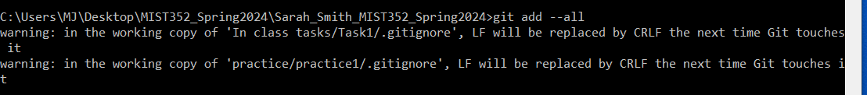
Push changes to GitHub using git
Now run the following commands in order:
2. Git add -all: this prepares changes to be pushed remotely by adding them for the next step
3. Run the command “git status” again, do you see anything different?

Slide 53
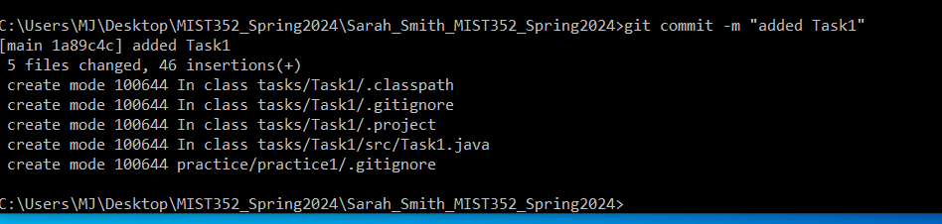
Push changes to GitHub using git
Now run the following commands in order
4. Git commit –m “added Task 1”: This is named a commit. Basically you are asking git to commit the changes. You should always provide the description of the changes you made between the “”. In this case, I added Task1 code, so I would type something like added Task1.

Slide 54
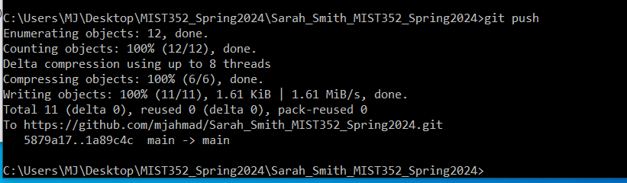
Push changes to GitHub using git
Now run the following commands in order
4. Git push: This ”pushes” the changes to GitHub. It syncs your local repo to GitHub.
Now see what happens when you try git status

Slide 55
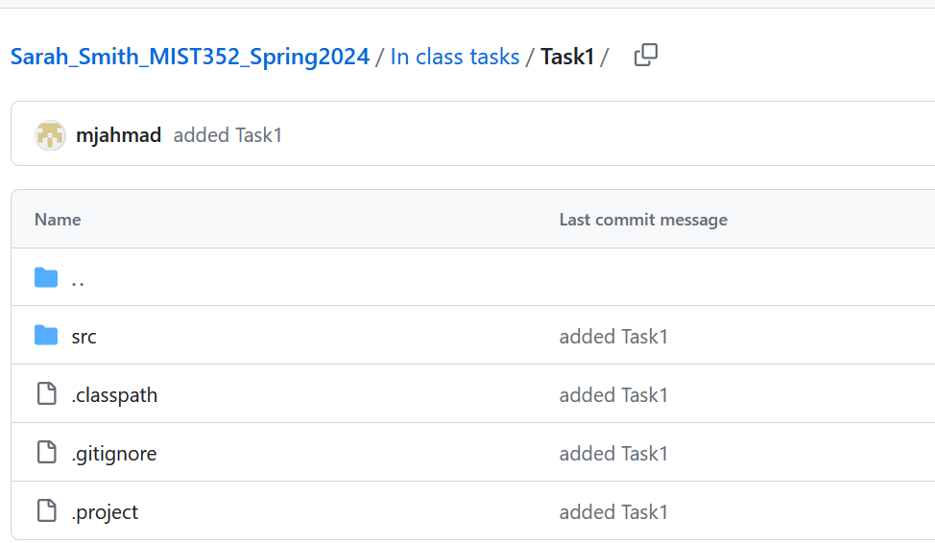
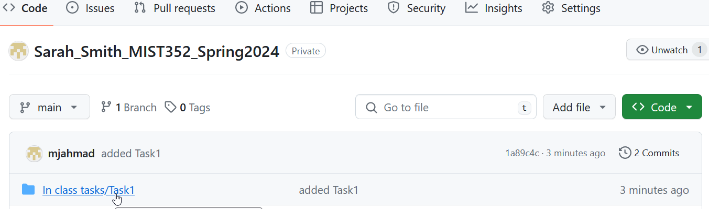
How do you verify and ensure your code is pushed correctly?
There are several ways:
Go to GitHub and check your repository, do you see the project/ data you added? Do you see the commit?

Slide 56
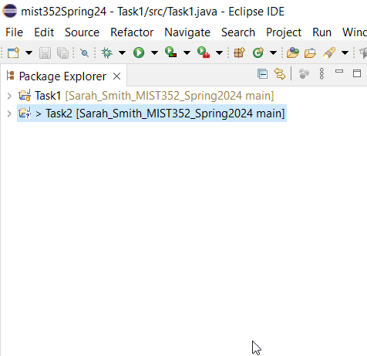
How do you verify and ensure your code is pushed correctly?
2. From Eclipse:
From the package explorer, If you see a ? Mark on the project’s name, then it has not been pushed correctly. If you see the other mark (as shown in Task1 of the screenshot), then your project has been pushed correctly.

Slide 57
Obtaining the latest code from the MIST352 repo
Although all codes will be released at once
Dr. Ahmad might upload code during classes or for homeworks
You will need to update the MIST352 by “pulling” the latest copy of the code and obtaining any new codes
See next slide

Slide 58
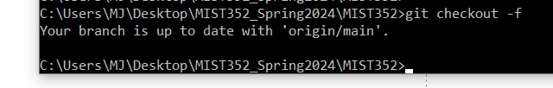

Obtaining the latest code from the MIST352 repo
run these commands in this order:
Git checkout -f
Git clean –fd
Git pull

Slide 59
Last notes
Every time you create a new project or modify an existing one, you have to run the four past commands to sync everything t GitHub
Always go to GitHub and verify that you can see your project there
You may still commit code from Eclipse however, this has shown to be problematic.

Slide 60
Eclipse, Git, and GitHub Desktop installations and Integration with GitHub.

Slide 61
What is Git?

Slide 69
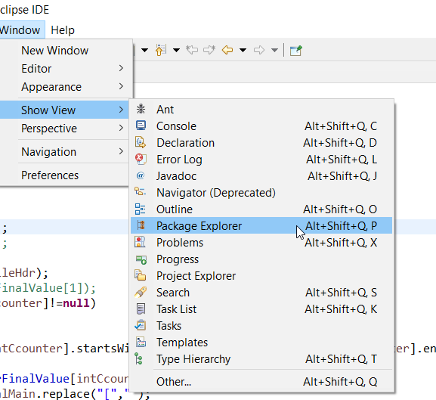
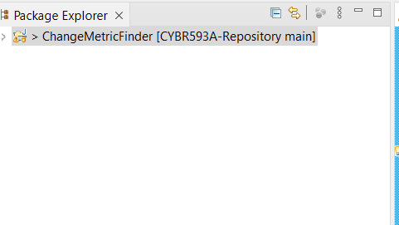
View Package Explorer
Start Eclipse
Navigate to Window menu -> Show/View
Select Package Explorer: Now you can see the structure of your projects

Slide 70
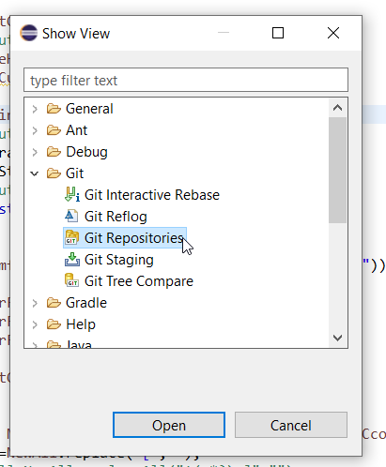
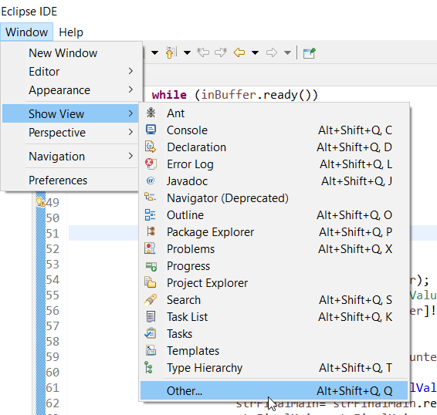
Enable Git controls
Start Eclipse
Navigate to Window menu -> Show/View ->Others
Select Git

Slide 71
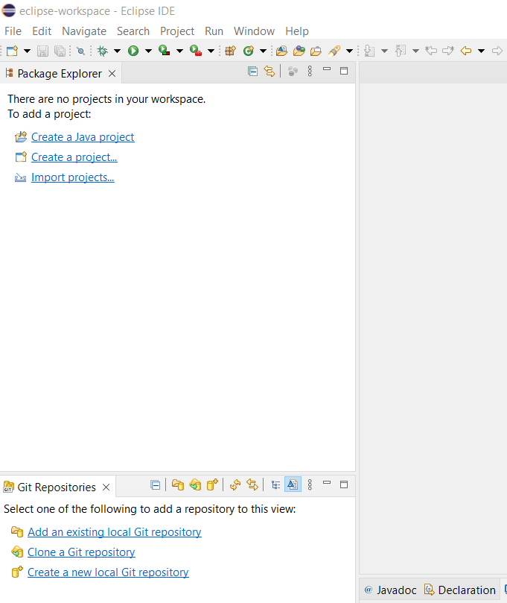
Eclipse Main Screen
Now you should see something similar to the screenshot
You should see Package Explorer
You should see Git Repositories

Slide 72
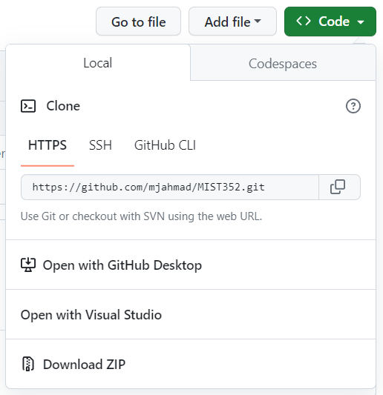
Clone GitHub Repo using Eclipse
First, lets clone your personal repo
Get the link to your repo from your repo’s page -> Code ->Local ->HTTPS -> copy link

Slide 73

Clone GitHub Repo using Eclipse
Before you can clone a GitHub repo to your eclipse, you need to obtain a personal Token from the GitHub website.
Navigate to GitHub.com -> login using your mix account
Go to your profile icon and click on Settings

Slide 74

Clone GitHub Repo using Eclipse
Scroll down to Developers Settings
Under Personal access tokens -> Tokens (classic) ->Generate new token (classic)
Give this token a name (MIST352) -> check all boxes. Save this token in a secured place. You will need this to integrate GitHub with Eclipse. You will not be able to view this again.

Slide 75

Clone GitHub Repo using Eclipse
In Eclipse:
Git Repositories -> Clone a Git repository
URL: URL of your repo
Host: Leave as is
Repo path: L:eave as is
User: Your GitHub user name
Password( Token obtained from Slide # 32) -> Next

Slide 76

Clone GitHub Repo using Eclipse
You should see this screen, if not, then you need to make at least one commit to your repo.

Slide 77

Clone GitHub Repo using Eclipse
Finally, check those two boxes as shown in the screenshot. And click finish
Save the password
You might be asked to setup password recovery questions. Go ahead and do that.

Slide 78

You now should see your repo under Git Repositories

Slide 79


Create project in Eclipse
Under File menu -> go to New -> Java projects
Provide project name. Keep last box unchecked -> Finish
You should see your project under the Package Explorer tab

Slide 80


Add Java classes to your project
Navigate to your project ->src folder ->right click -> New -> class
Provide name -> check all boxes as shown in screenshot below -> Finish

Slide 81

Add Java classes to your project
This is yoiur main file. Now you can start coding here

Slide 82


Push your project to your repository
Right click on your project -> Team -> Share project
Select your repo ->Finish

Slide 83

Push your project to your repository
Right click on your project -> Team -> Commit

Slide 84

Push your project to your repository
Click on the ++ icon to include all changes
Provide a Commit Message -> PUSH HEAD

Slide 85


Push your project to your repository
Click on the ++ icon to include all changes
Provide a Commit Message -> PUSH HEAD -> PREVIEW
Then PUSH ->Close.
Your project should be in the repo now.

Slide 86
Remember
Remember to commit and push every time you make changes to your code
You can clone more than one repo:
Your personal: You will be submitting most of your code here
Class’s repo: You can only clone and view codes posted there

